Slide 1
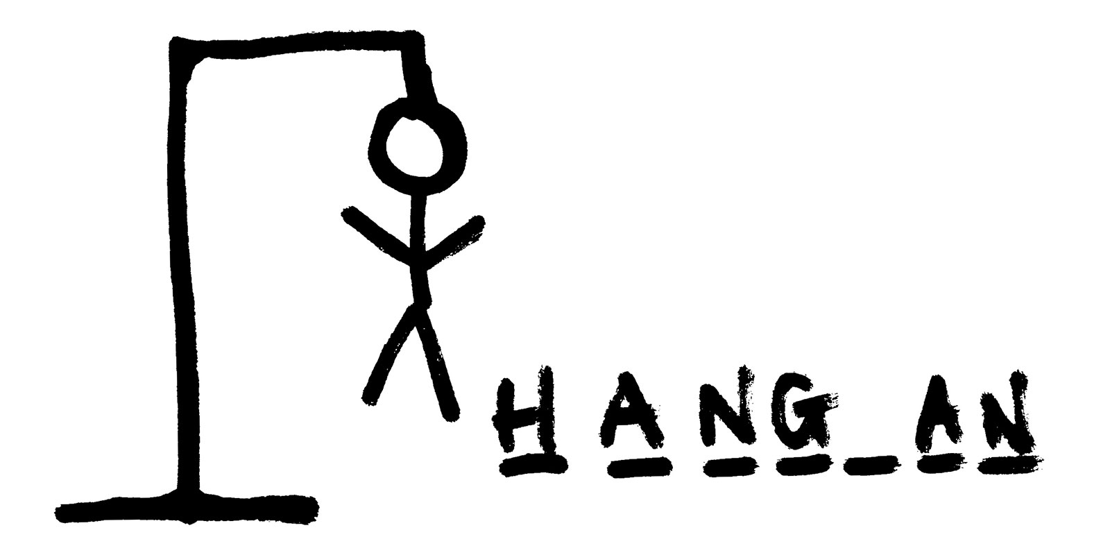
Guess the Word!
A classic ‘Hangman’ game that just simply never gets old.
CODER: Caique Melo
Original coders: upatel1-hub, Kamilah633, and Nicole mud
https://github.com/cmelo4/Guess-the-Word-

